Slide 1

G2014 Azzurri Storm Parents & Players

Slide 2
AGENDA
Coach Will
Winning Culture
Player Expectations
Tribe Expectations

Slide 3
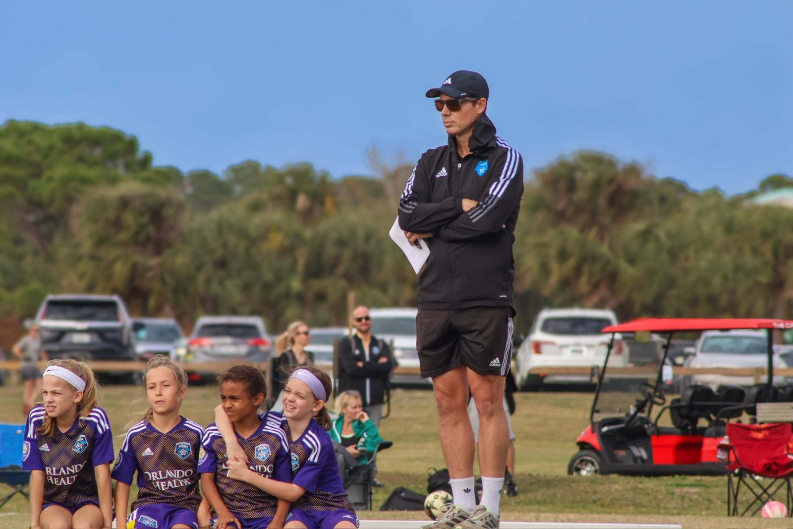
Who is Coach Will?

Slide 4
Coach Will
My roots
My childhood -- #14
My family
My Faith

Slide 5
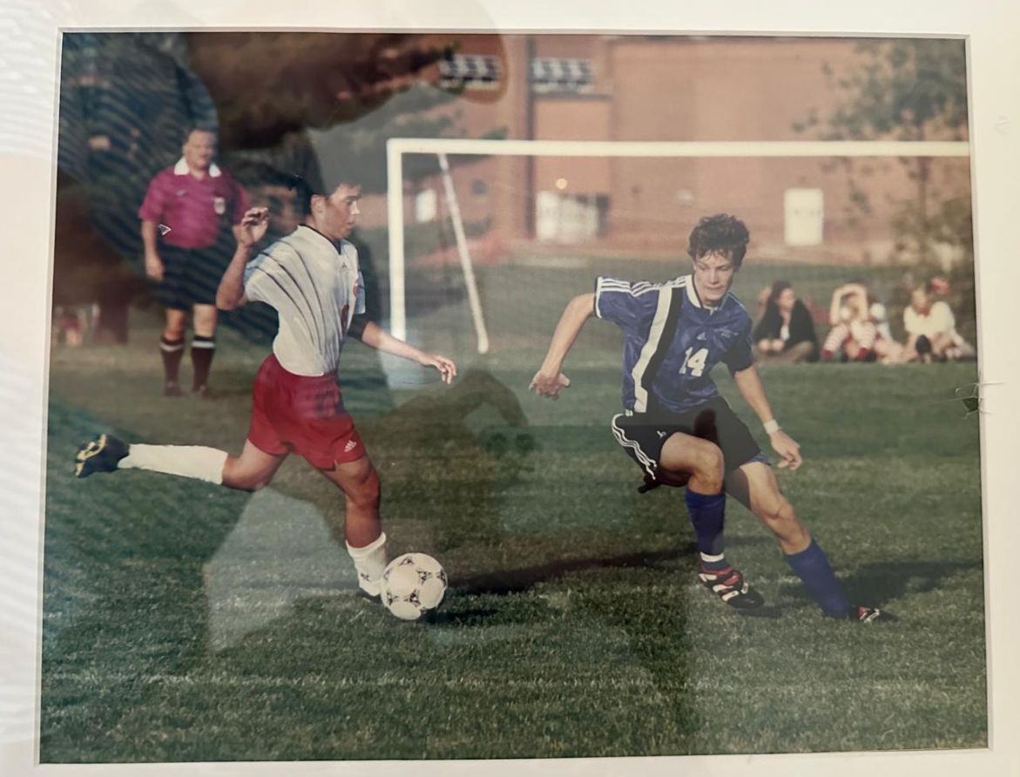

Slide 6
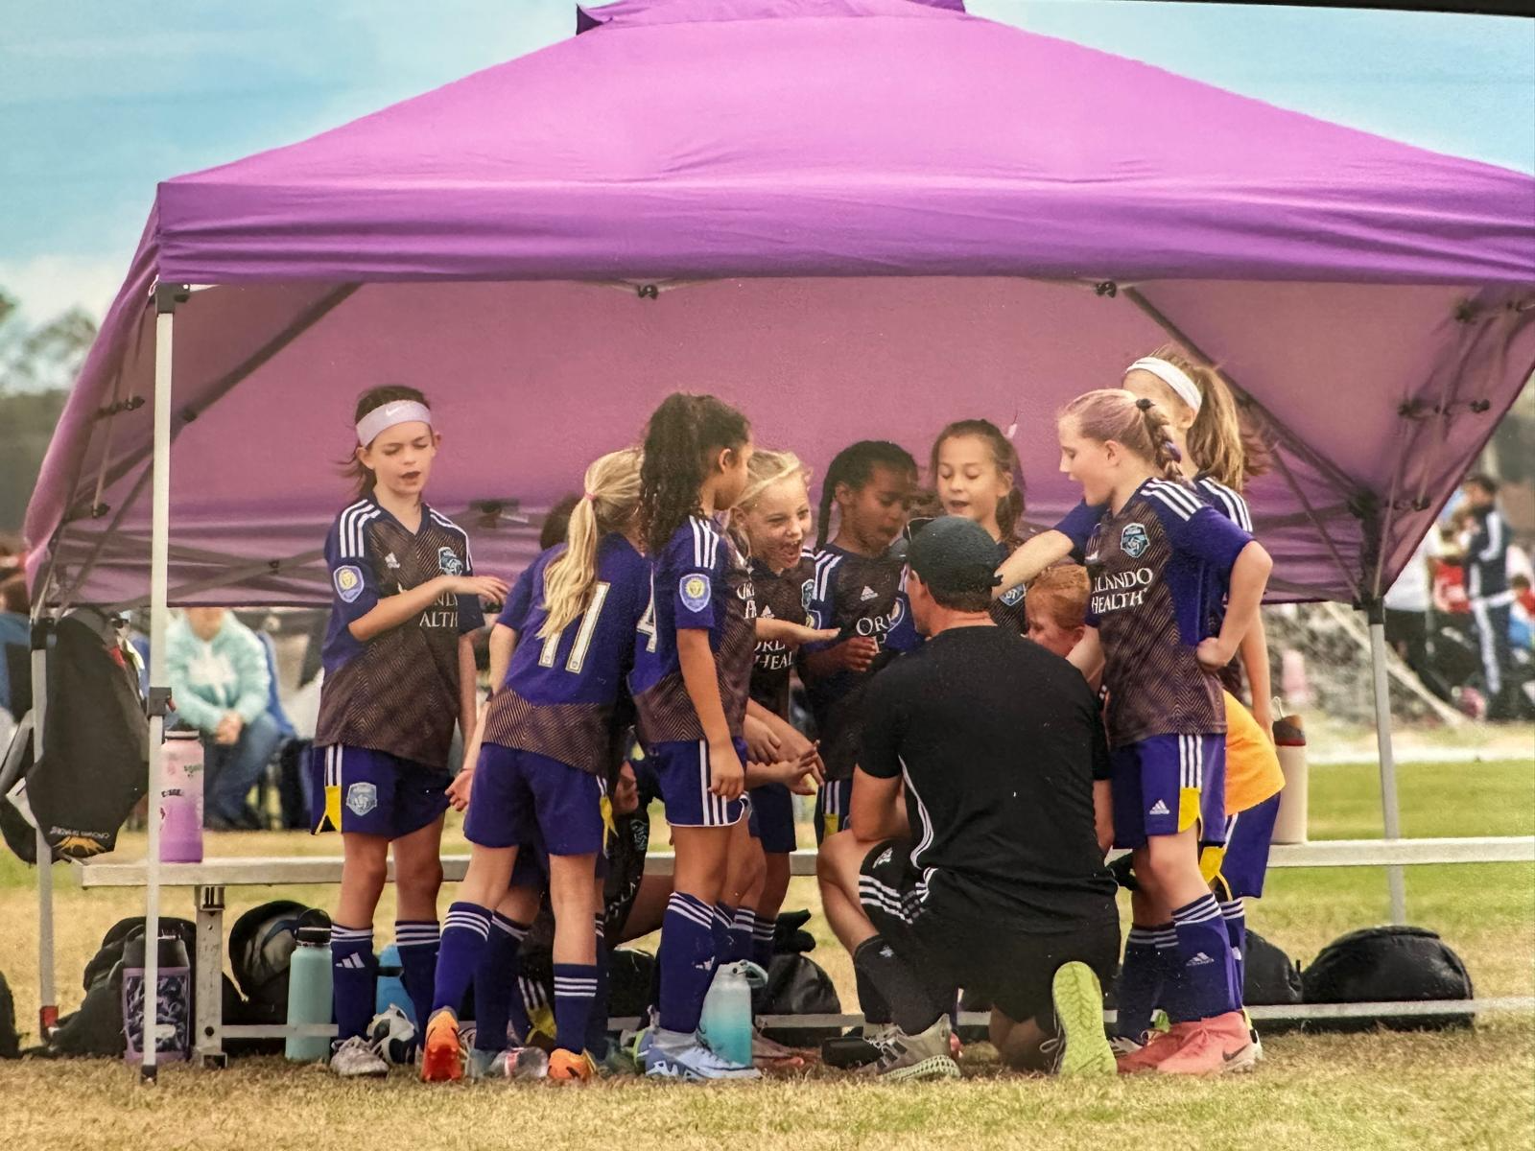
Why I coach

Slide 7

Building a winning culture

Slide 8
World Population (Millions)

Slide 9
Building a winning culture
Defining the game
Permission to win
“Excellence Everywhere”
“CDE”
Defense wins championships
Setting a vision

Slide 10
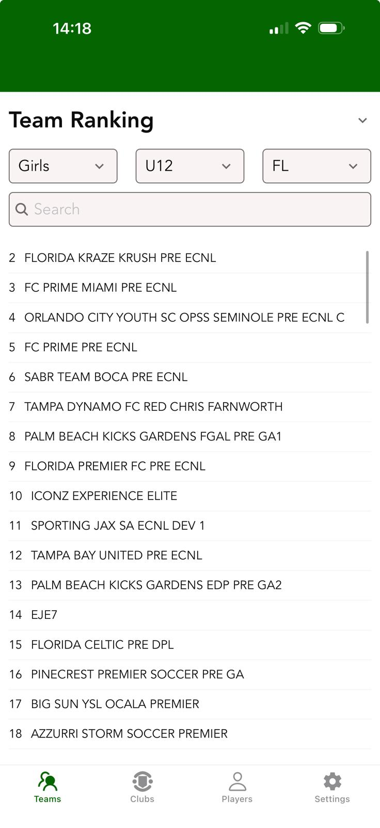
[Remain/Become a top __ team in the state in the next 12 months by building a tribe and CULTURE committed to excellence
Last Year
Next Year?

Slide 11
Player Expectations

Slide 12
RULE OF three
Partnership 1 | Partnership 2 | Partnership 3 | Partnership 4
Baylor | Susie | Reese | Hailey
Myra | Noelle | Marie | Hannah
Camryn | Mady | Charlotte | Melissa
London | Caroline | Ellie | Kaia
YOUR COACH HERE
YOUR TEAM HERE
YOUR NAME HERE

Slide 13
Summer of opportunity
There’s a lot of time to
advance your game this summer
if you commit
Fall of 2026
Spring 2027
Summer 2026
17 Weeks
10 Weeks
20 Weeks

Slide 14
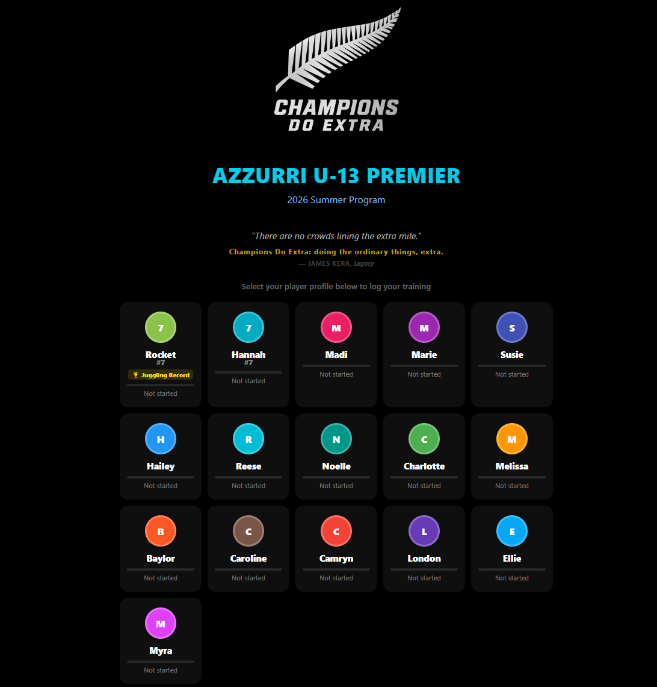
Summer of opportunity

Slide 15
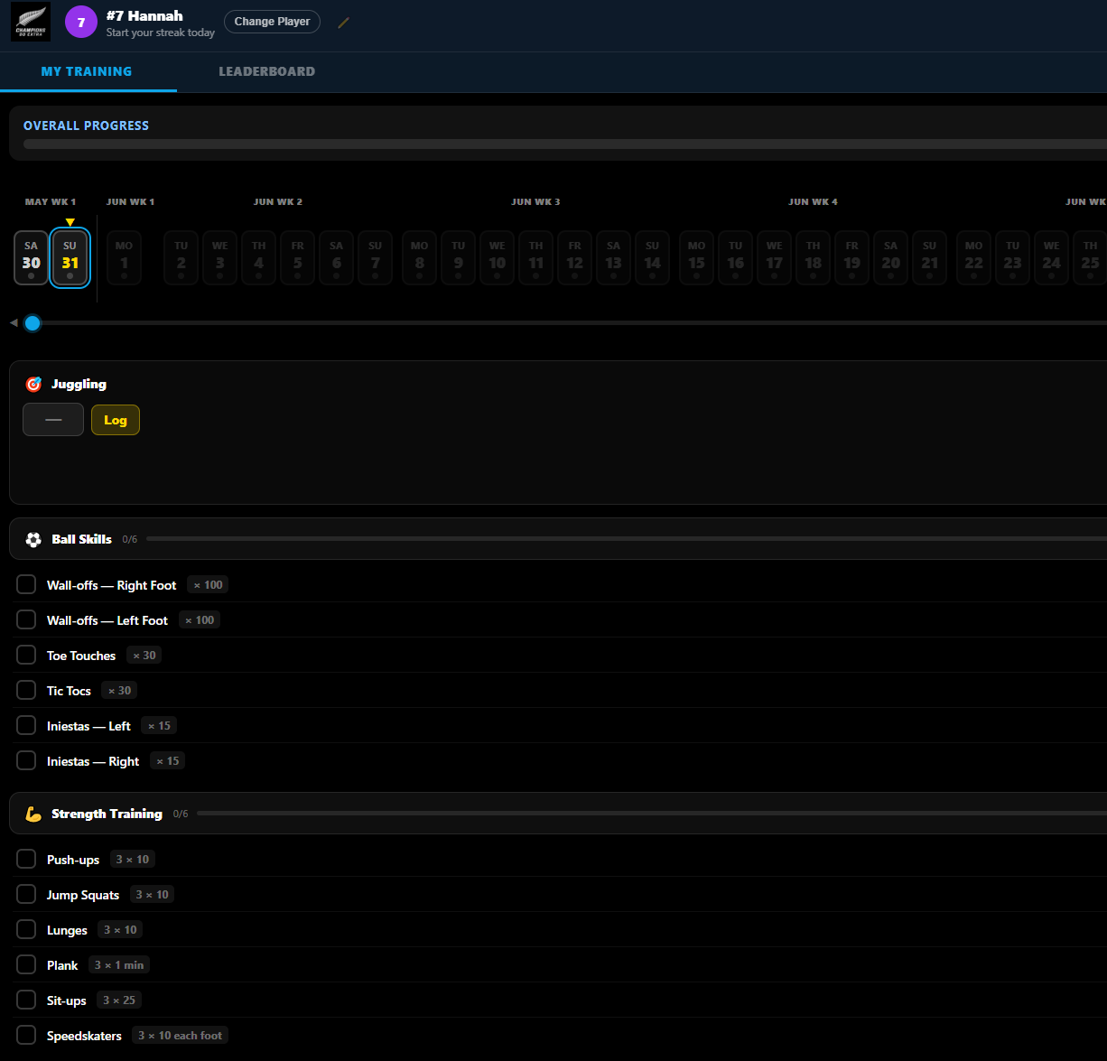
Summer of opportunity

Slide 16
2026 Summer of Success
Personal Work
Team Time
Define your commitment and Pick “one thing”(to improve the most)
Make your commitment known to your family, your team and your coach
Make a goal for yourself, share with your team
Hold your partner accountable
Do the work, share the work
Let’s have fun, encourage one another…commit together:
Kick arounds
Left foot sessions
Fitness Sessions

Slide 17
2026 Summer of Success -- IDEAS
Personal Work
PERSONAL PLAN AT HOME – CDE Website
Basics + advanced
Super 7s
Left foot (work off the walls…100s of times)
Juggling (show up with 25 in August)
BILD STRENGTH TRAINING
SWIM TEAM, GYMNASTICS
Futsal, 3v3 and 5v5
Running
Summer Fun Runs GC Runners
SIGN UP FOR A 5K
Run each day

Slide 18
TRIBE Expectations

Slide 19
2026-2027 Tribe Expectations
Families
Group
Commit now
Communicate well
Schedule – Coach Will / Brooke
Sundays
Away / Home
9v9
Rides
Tent
Gear (GoFundMe)
Photographer
Veo

